Slide 1
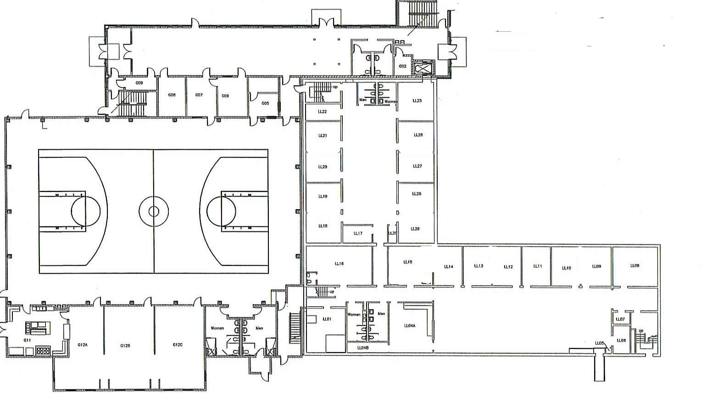
West Broadway Baptist Church
8420 Six Mile Ln
502-491-1920
HISTORIC DRIVE
D-2
D-3
Main Entrance
A-1
N
C-4
A-2
NARTHEX
D-1
C-3
G09
ELEVATOR
G08
G07
G06
LL25
G05
LL21
LL21
LOWER LEVEL & GROUND FLOOR
LL26
RAINBOW
AREA
LL20
LL27
LL19
LL28
LL18
LL21
LL29
LL16
LL15
LL14
LL13
LL12
LL11
LL10
LL09
LL08
C-2
SIX MILE LANE
KITCHEN
G12A
G12B
G12C
LL01
LL04A
OLD FELLOWSHIP HALL
OLD
KITCHEN
NEW FELLOWSHIP HALL
B-1
C-1
B-2

Slide 2
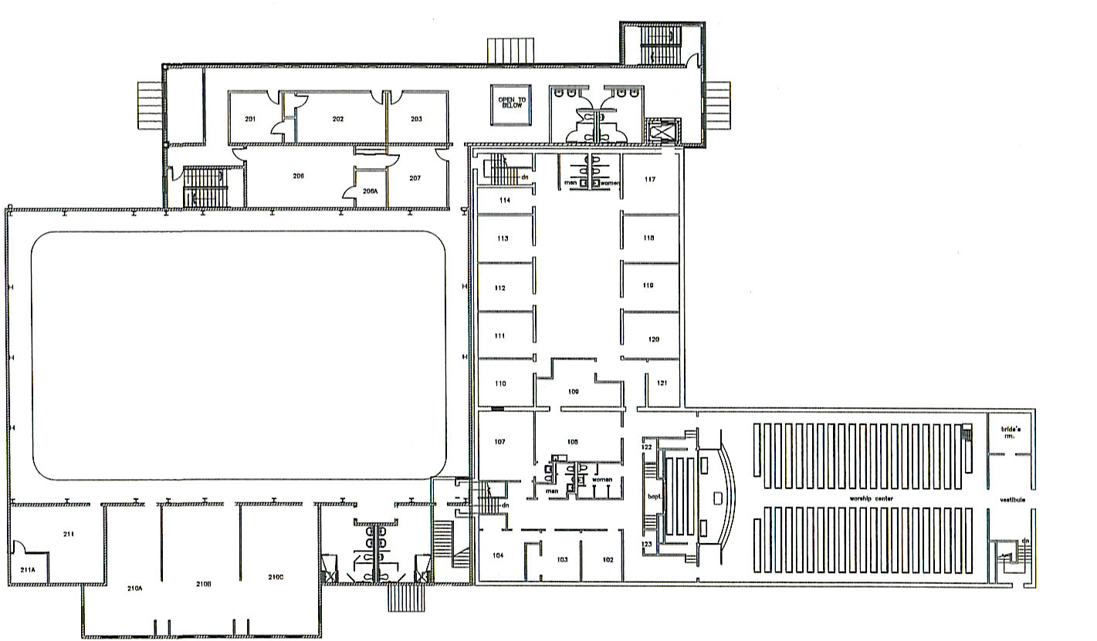
HISTORIC DRIVE
N
2nd FLOOR NARTHEX
1ST & 2ND FLOORS
201
202
203
206
206A
207
ELEVATOR
OLD
CHOIR
ROOM
SIX MILE LANE
SANCTUARY
211
210A
210B
210C
A-3
211A
B-1
B-4
B-3

